Slide 1

Montreal Road Accidents Study
By Asphalt Detectives ( Khaled Fouda, Chaohua Chen)

Slide 2
Agenda
1, Motivations
2, Features overview
3, Methodology
4, Models Evaluation

Slide 3


I. Motivations
-Montreal is infamous of its bad road conditions and tremendous amount of road constructions.
- "Orange cone" city
- To help our community, we initiatively thought to predict roads conditions across Montreal.

Slide 4
Feasibility
Road Conditions Forecasting:
Difficulties:
-thousands of streets, intersections, and blvds.
-Cannot identify the streets and its associated name on the map.
-limited amount of available datasets.
-Too expensive to acquire advanced data.

Slide 5
Alternativity
Montreal Road Accidents Forecast
- Car collision data --- Montreal open data
- Weather dataset --- Environment Canada
- Our Target: Forecast the number of road accidents

Slide 6

II. Features Overview - Time variables - Loss and Damages - Accident Nature - Location Variable

Slide 7
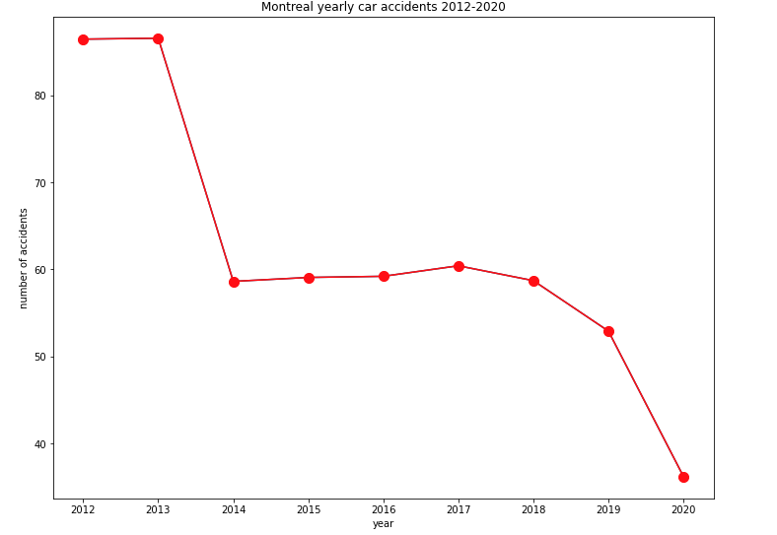
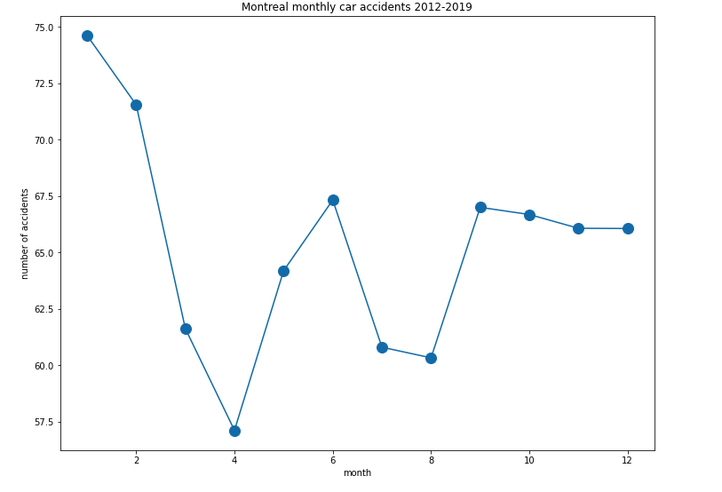
Time Variables -year -week -date -hour

Slide 8
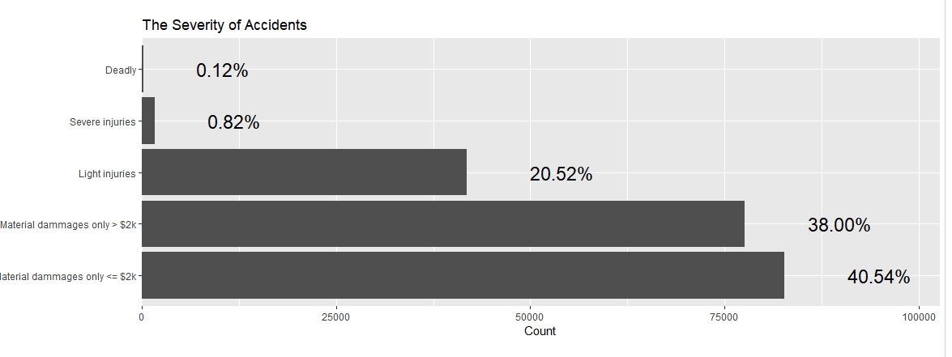
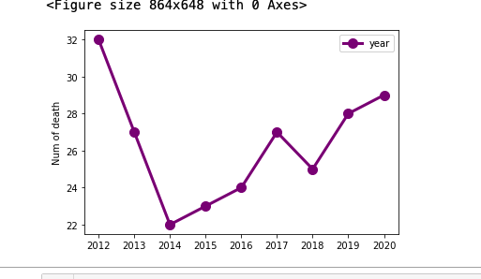
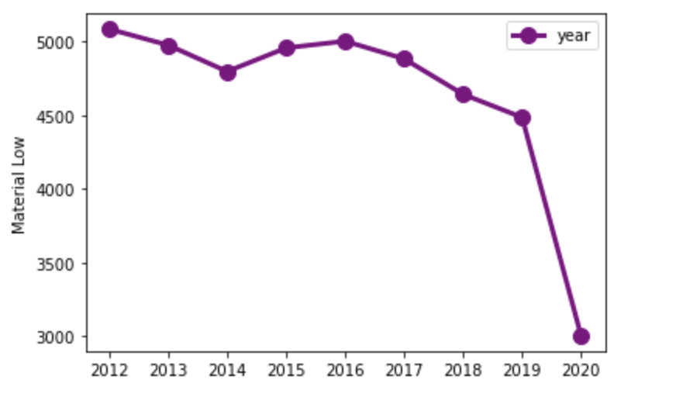
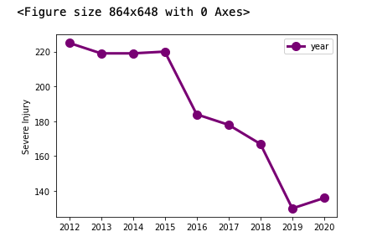
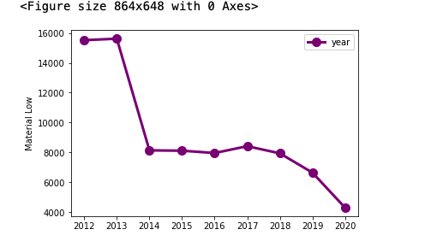
Loss and Damages -Deadly -Severe Injury -Light Injury -Material Damage Low -Material Damage High

Slide 9
Accidents Nature - Weather Conditions - Surface Conditions - Moving subjects - Auto-Speed
Some facts:
More than 60 percent of road accidents happened during the clear daytime.
More than 70 percent of Death occurred where the road surfaces are dry
More than 80 percent of road accidents happened in residential & commerical areas
Car accidents happened at an average speed of 46.5 km/h

Slide 10
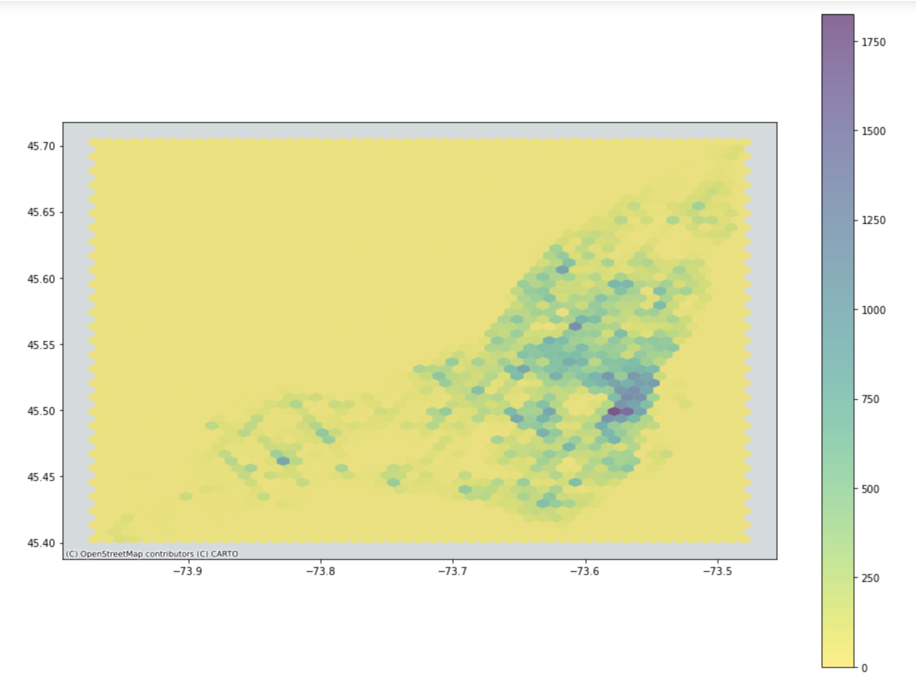
Location Variables -Longitude -Latitude
Regions:
Ville Marie
Le Plateau-Mont-Royal

Slide 11
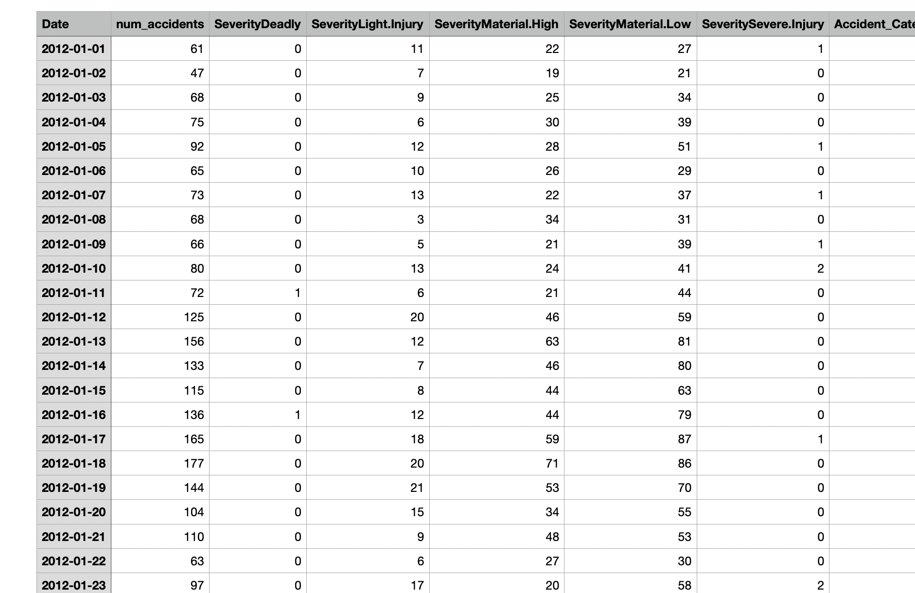
Aggregate Data
-Car collisions + Weather -Time series format by days: from 2012-01-01 to 2020-12-31
-Has 56 features e.g counts of Victims, counts of surface conditions, counts of Illumination 2f
-

Slide 12

III. Methodology -Multi-Seasonality-Trend Decomposition Using Losses (STL) and Ridge Regression -Recurrent Neural Networks – Long short-term memory (LSTM) : Multivariate & Univariate

Slide 13
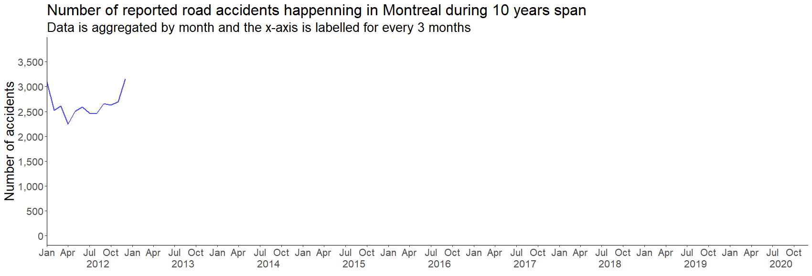
Number of Accidents per year

Slide 14
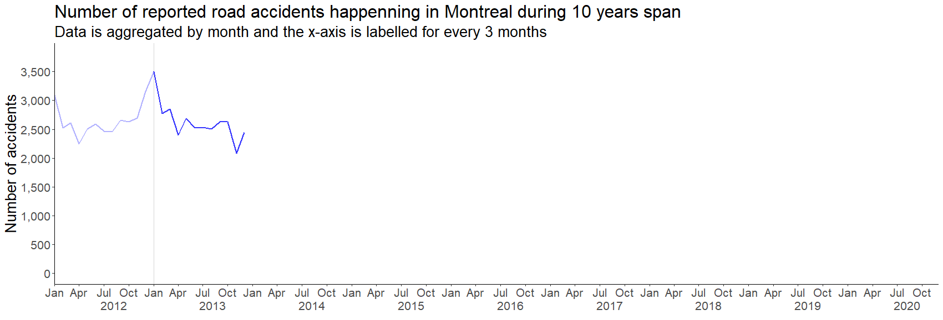

Slide 15
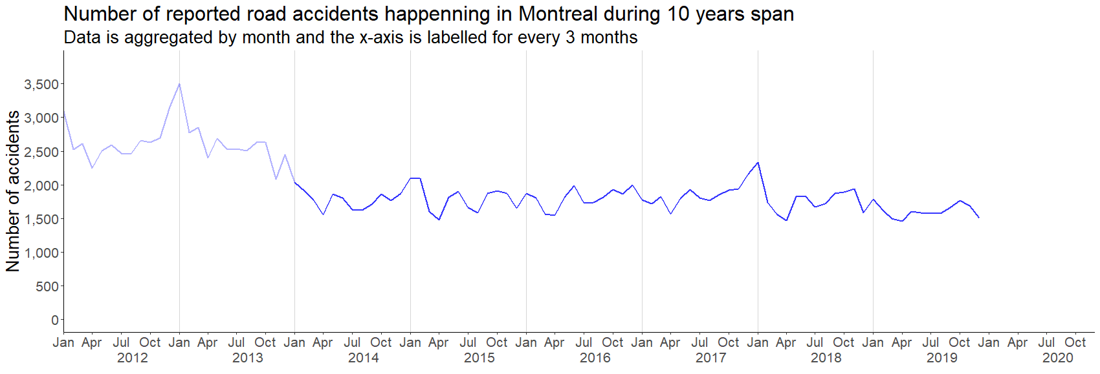

Slide 16
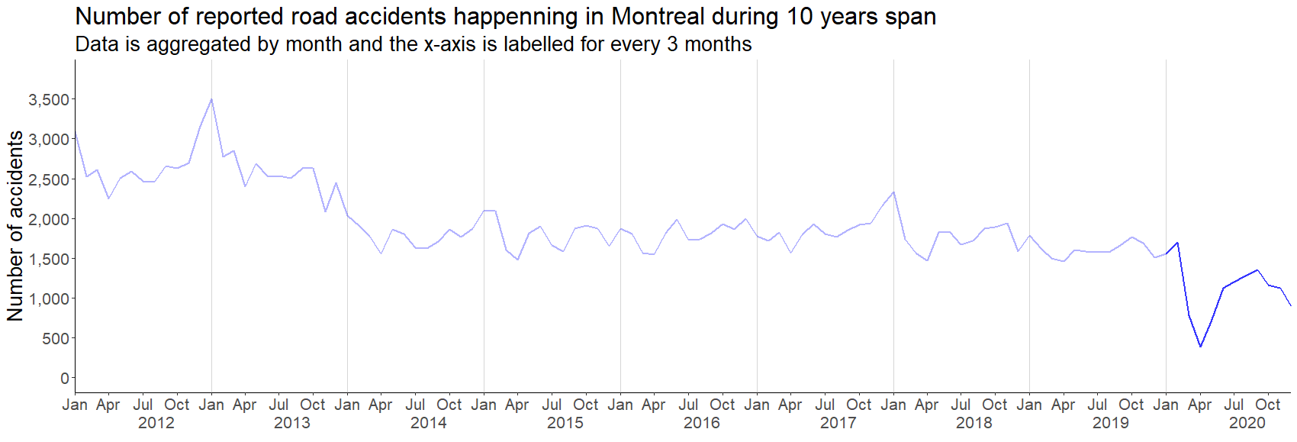

Slide 17
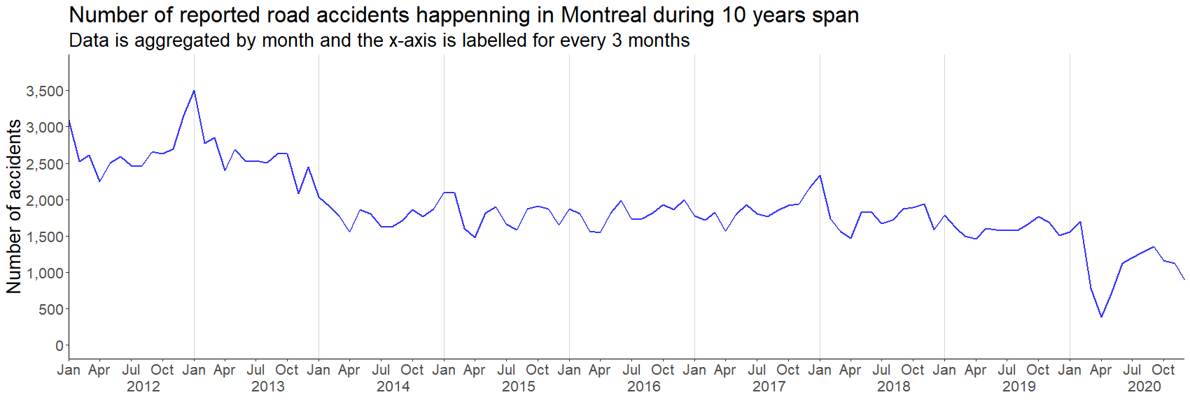

Slide 18
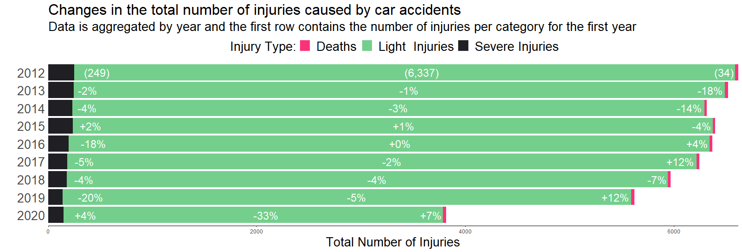
Injury type by year
Although we’re witnessing a decrease of the total number of accidents each year, we observe an increase in the number of deaths and severe injuries

Slide 19
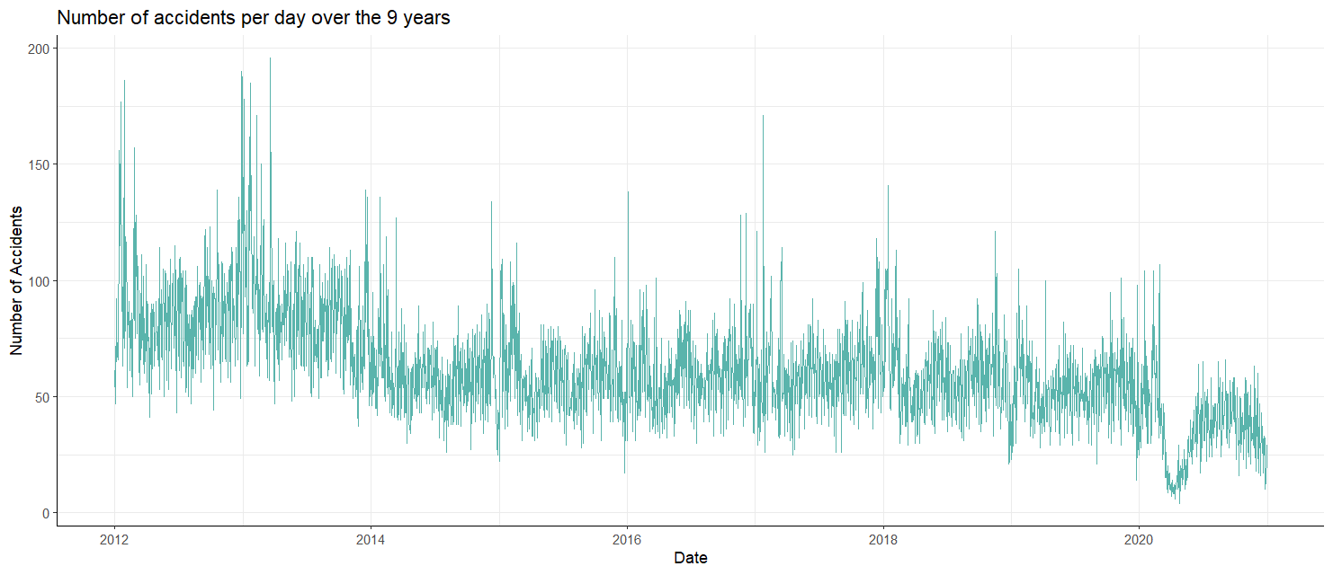
Objective:
- Model and Forecast the number of accidents per day using weather and road conditions data.
Input: past weather and road conditions and accident data
Output: Number of accidents happening tomorrow

Slide 20
- Step 1: Time-Series Analysis
Daily data with a 365/366 seasonality period
ARIMA models require periods less than 255
Our data have multiple seasonality periods.
MSTL model allows us to define multiple seasonality periods.
$$Y_{t}=Trend_{t}+ \sum_{d∈periods}{Seasonality_{t}^{d}}+Residuals$$
- Multi-seasonality-trend model with loess applies linear filters to extract trends and seasonality.
We selected seasonality periods of 28, 362, 363, 264, 365, 366
81% of variability was reduced by subtracting the trend and seasonality terms.
We aim to explain the variance of the residuals by applying a regression model to them.
Finally, we aim to predict the three terms (Trend, Seasonality, Residuals) for future values.

Slide 21
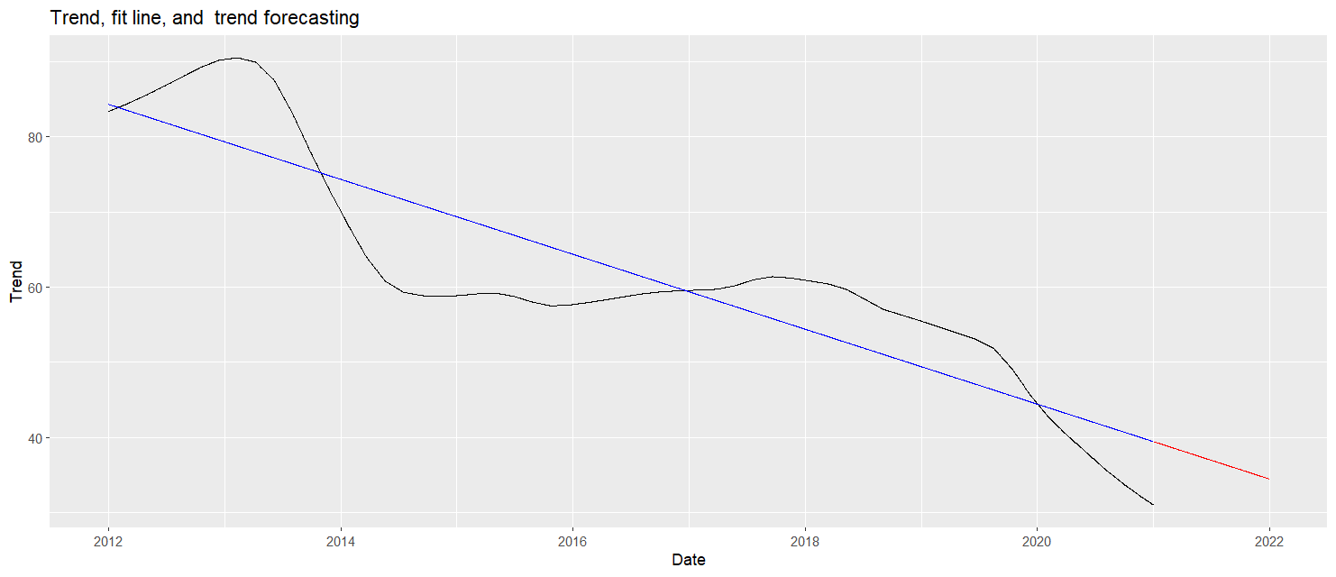
Trend
Where t is a time counter that starts on 2012-01-01

Slide 22
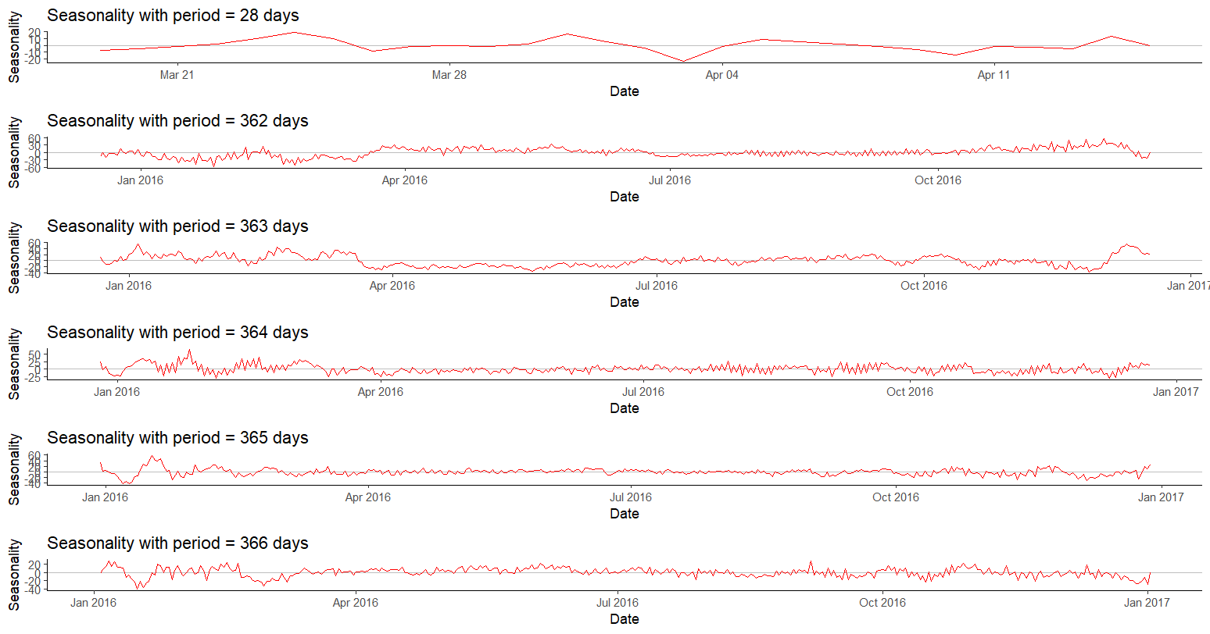
Seasonality

Slide 23
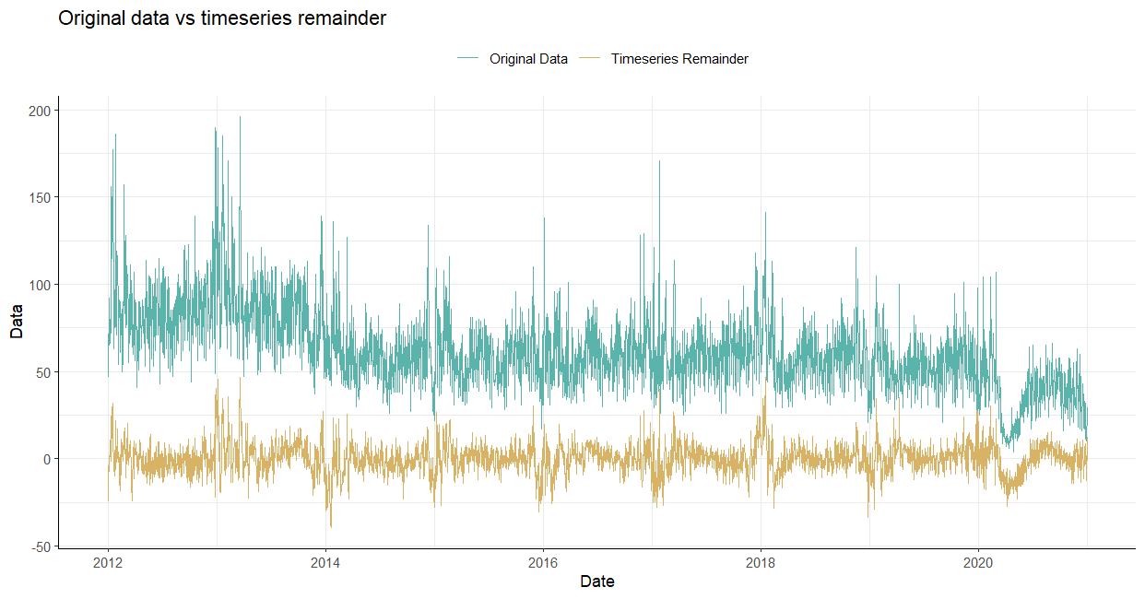
Residuals
- 81% reduction in variance.
- Has a zero mean but suffer from autocorrelation

Slide 24
Modelling the residuals
- For a day t,
- the response is the residual at day t, t
- the predictors are the weather and road features for days t-3 to t-1 as well as the residuals for days t-3 to t-1.
- Note that we didn’t use any features of the day t since they haven’t been observed yet.
Data was divided into a training set (70%) and a test set (30%)
Number of features including the lags is 464.
Ridge Regression:
- A regression model with L2 regularization penalty.

Slide 25
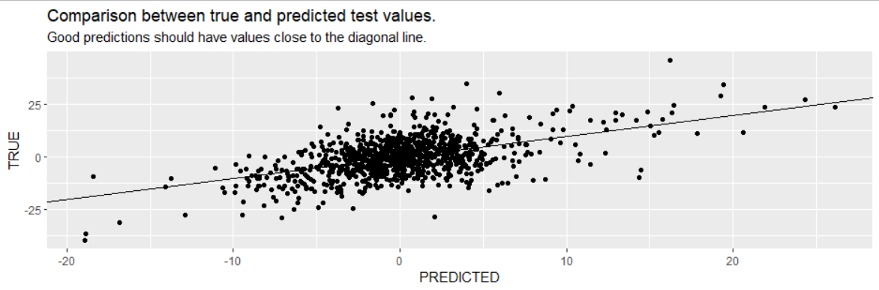
Ridge Regression Results
- Top effective features:
- the response of days t-3 to t-1
- Surface condition of day t-1
- Snowy weather of day t-1
- Light injuries of day t-1
The residual’s variance was reduce by 27.6% (test set) and hence we reduce the original data’s variance by 89%
The model achieved R^2 of 0.29 and .34 for the test and train datasets respectively.

Slide 26

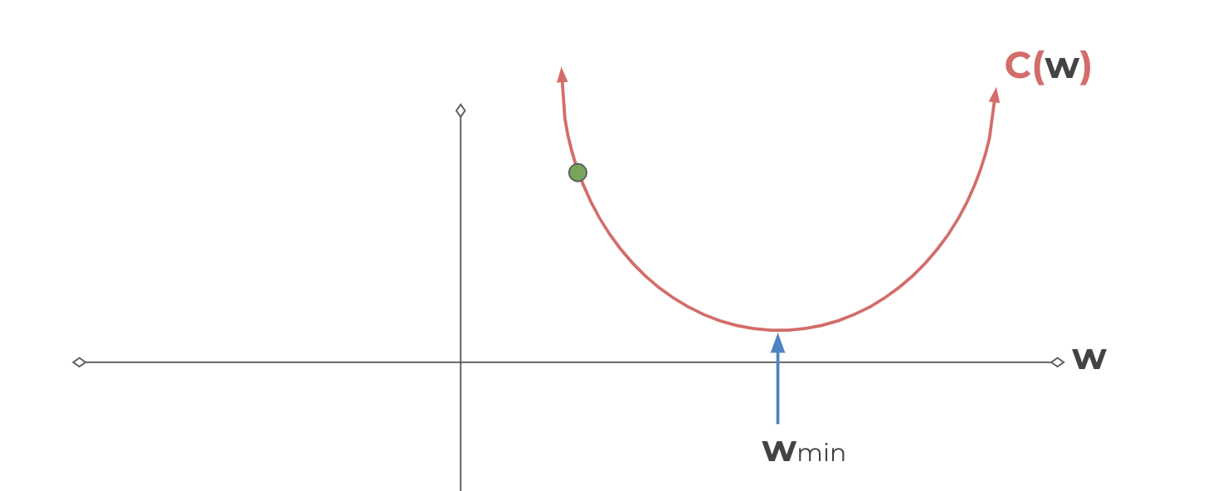
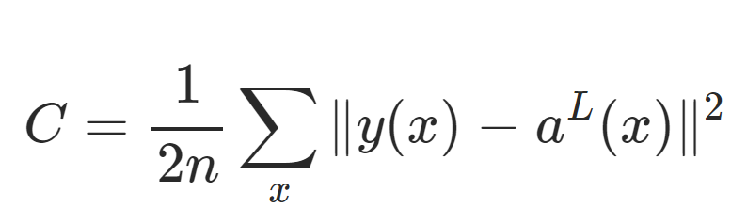
Artificial Neural Networks
X*w +b = z
Pass z into activation function: σ(z) = a
Y represents the true value, and a represents the predicted value
Source from JosePortilla:
https://docs.google.com/presentation/d/12oUP2g7gqpPBdZcmzuqH8_ttnzosOKA2cZKbOFJyPKU/edit#slide=id.g73ebe5debd_0_2139

Slide 27
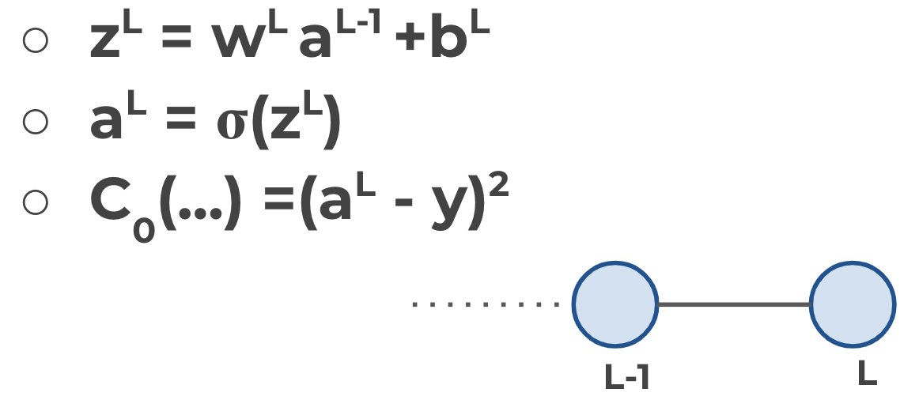
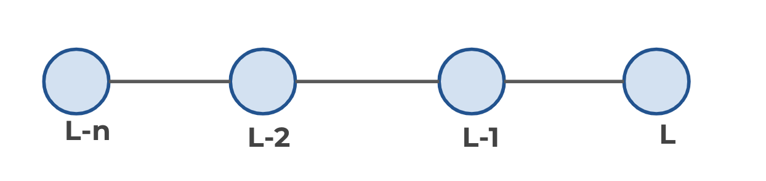
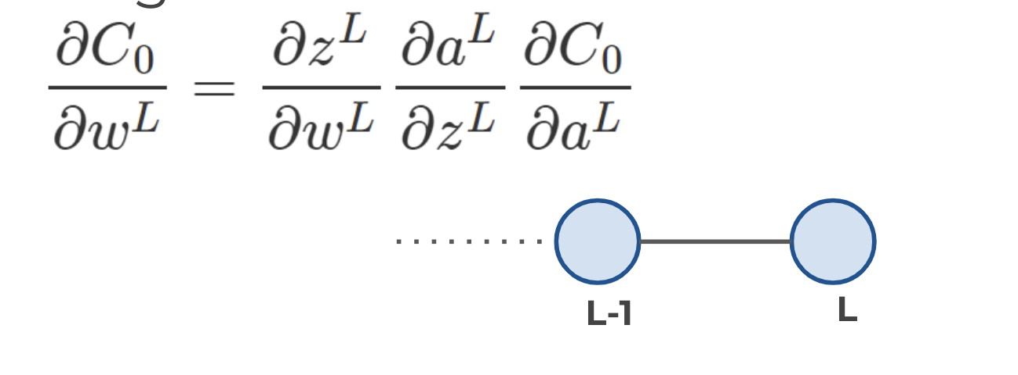
Backpropogation:
Main Idea
-we can use the gradient to go back through the network and adjust our weights and biases to minimize the output of the error vector on the last output layer.
(Since we are dealing with N-dimensional vectors, the notation change from derivative to gradient)
Source from JosePortilla:
https://docs.google.com/presentation/d/12oUP2g7gqpPBdZcmzuqH8_ttnzosOKA2cZKbOFJyPKU/edit#slide=id.g73ebe5debd_0_2139

Slide 28
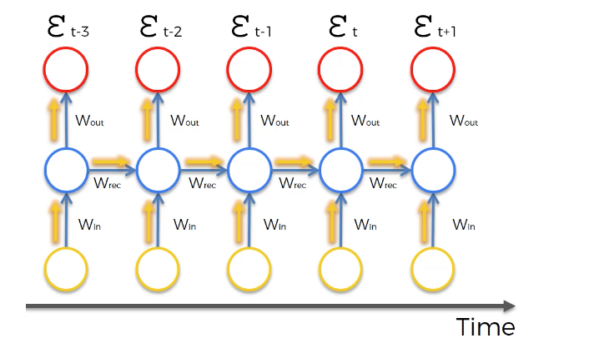
Recurrent Neural Networks
Vanishing Gradient Problem
Recurrent neural networks behave differently since the hidden layer of one observation is used to train the hidden layer of the next observation
Wrec < 1, vanishing gradient problem
Wrec > 1, exploding gradient problem

Slide 29
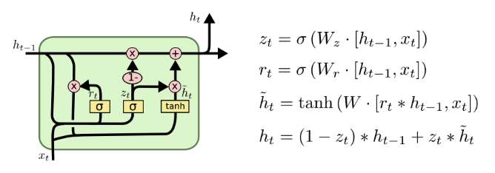
Recurrent Neural Networks - LSTMs
Source from : https://colah.github.io/posts/2015-08-Understanding-LSTMs/

Slide 30
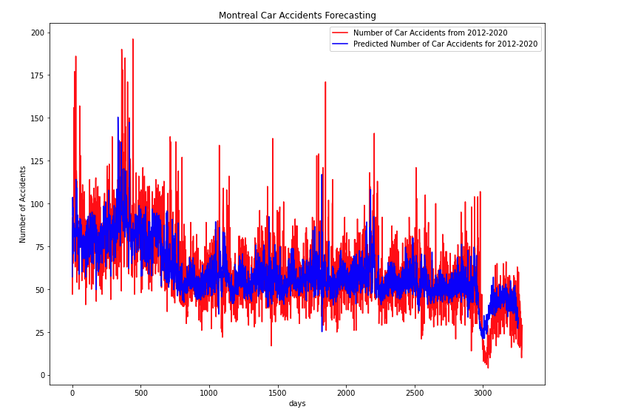
LSTM (Univariate)
Objective: ​
- Model and Forecast the number of accidents per day
- Input: past number of accident (lags: t = 3, 7, 28, 90....)
- Output: Number of accidents that will happen tomorrow

Slide 31
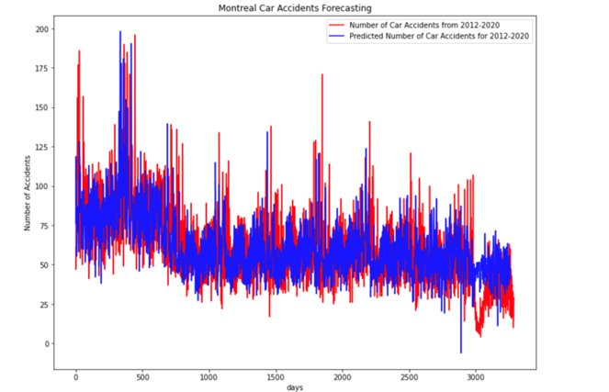
LSTM (Multivariate)
Objective: ​
- Model and Forecast the number of accidents per day
- Input: past number of accident (lags: t = 3, 7, 28, 90....) and other 55 features from aggregate data
- Output: Number of accidents that will happen tomorrow

Slide 32

IV. Model Evaluation

Slide 33
Mean Squared Error
LSTM univariate: 139.25 (the best)
LSTM Multivariate: 70.3 (the best)

Slide 34

V. Conclusion

